Slide 1
A Brief Survey on Feature Models’ Analysis
Wang, Bo
2010-01-06

Slide 2
Review
Last discussion
  The details of SkyBlue
    Incremental Checking
    Constraints Hierarchy
  A rough idea about what I want to do
    Construct Feature Model
    Debug Feature Model
    Configure Feature Model

Slide 3
Today’s Discussion
A brief survey of feature models’ analysis
Some examples about our work
Today’s Objective:
  Comments about the papers I read
  Suggestions for others’ work
  Suggestions for our work
  Suggestions related to the key points in the papers

Slide 4
Next Discussion
The details about our implementation
  Performance (Speed, Memory)
  Tool

Slide 5
Outline
Feature Models
Analysis Operations
Automated Support
Our Work

Slide 6
Outline
Feature Models
Analysis Operations
Automated Support
Our Work

Slide 7
Feature Models
Basic Feature Models (1990)
Our Feature Model (2005)
Cardinality-Based Feature Models (2002)
Extended Feature Models (1998)

Slide 8
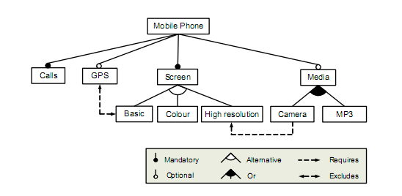
Basic Feature Model
from Kang, 1990, FODA Feasibility Study, CMU/SEI-90-TR-21

Slide 9
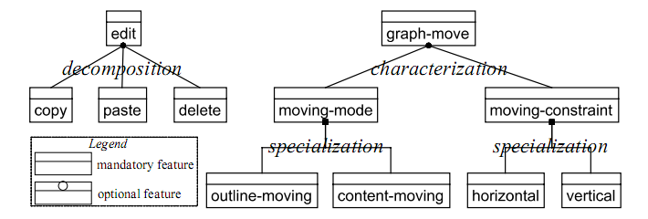
Our Feature Model
Refinement Relationship
from Zhang, MoDELS 2005, SoSyM2006, REJ2006

Slide 10
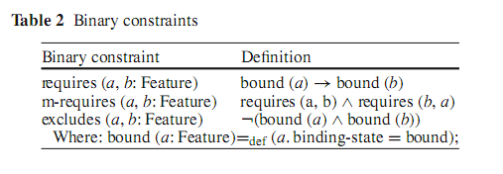
Our Feature Model
Constraints
from Zhang, MoDELS 2005, SoSyM2006, REJ2006

Slide 11
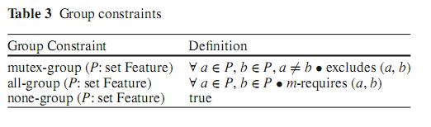
Our Feature Model
Constraints
from Zhang, MoDELS 2005, SoSyM2006, REJ2006

Slide 12
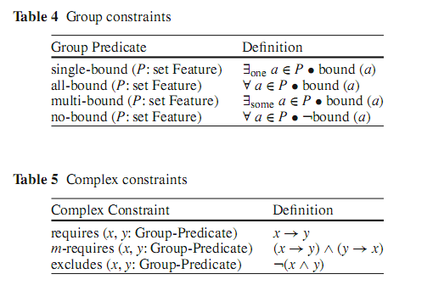
Our Feature Model
Constraints
from Zhang, MoDELS 2005, SoSyM2006, REJ2006

Slide 13
Our Feature Model
Can express the Or and Alternative Constraint
A
A mrequires B
C requires A
D requries A
A requires Multi-bind(B,C,D)
B
C
D
from Zhang, MoDELS 2005, SoSyM2006, REJ2006

Slide 14
Our Feature Model
Can express the Or and Alternative Constraint
A
B requires A
C requires A
D requries A
A requires Single-bind(B,C,D)
B
C
D
from Zhang, MoDELS 2005, SoSyM2006, REJ2006

Slide 15
Review：Basic Feature Model
from Kang, 1990, FODA Feasibility Study, CMU/SEI-90-TR-21

Slide 16
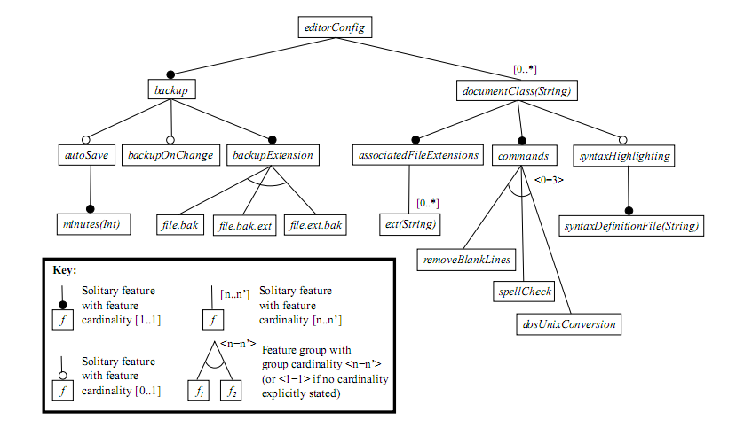
Cardinality-Based Feature Models
Feature Cardinality and Group Cardinality
from Czarnecki, Software Process: Improvement and Practice,2005

Slide 17
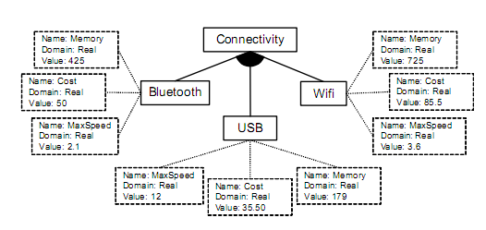
Extended Feature Models
from Benavides, Automated Reasoning on Feature Models, CAiSE2005

Slide 18
Outline
Feature Models
Analysis Operations
Automated Support
Our Work

Slide 19
Analysis Operations
—Model Constraints Checking
Trying to assigning values to the features that satisfy all the constraints.
Helpful when analysts want to debug relatively large feature models.

Slide 20
Analysis Operations
—Valid Product
Validating whether a product belongs to the set of products represented by the feature model or not.
Helpful when analysts want to determine whether a product is available in the product line.

Slide 21
Analysis Operations
—Valid Partial Configuration
Validating a partial configuration by trying to extend it to a valid full configuration.
Helpful
  When analysts debug the feature model
  When customers configure the feature model

Slide 22
Analysis Operations
— All Products
Providing all the products represented by the model.
Helpful when analysts want to identify new valid products not considered in the initial scope of the product line.

Slide 23
Analysis Operations
— Number of Products
Providing number of products represented by the feature model.
Help when the analysts want the information about the flexibility and complexity of the software product line.

Slide 24
Analysis Operations
— Filter
Providing derived products that includes the input configuration (filter).
Helpful
  Filter the set of product according to their key requirements.
  Inspect the list of resultant products to select the desired solution.

Slide 25
Analysis Operations
— Anomaly Detection
Detect
  Dead Features
  False Optional Features
  Redundancies
Not conflicts, but can lead to conflicts

Slide 26
Analysis Operations
— Explanations
Providing information about the reasons of why or why not the corresponding response of the operation.
Explanation should be minimal.
Helpful when constructing, debugging and configuring feature models.

Slide 27
Analysis Operations
— Corrective Explanations
Providing solutions to change the corresponding response of the operation.
Helpful when constructing, debugging and configuring feature models.

Slide 28
Analysis Operations
— Feature Model Relations
Feature Model Relations
  Refactoring
  Generalization
  Specialization
  Arbitrary edit
Helpful when determining how a feature model evolves over time.

Slide 29
Analysis Operations
— Optimization
Help customer derive a product which fulfils a criteria.
The criteria is defined by a function which take the attributes of the features as input.
Useful in the extended feature models.

Slide 30
Analysis Operations
— Core Features
Providing the set of features that are part of all the products in the software product line.
It is helpful
  when determining which features should be developed in first place.
  when deciding which features should be part of the core architecture of the software product line.

Slide 31
Analysis Operations
—Variant Features
Providing variant features that do not appear in all the products of the software product line.

Slide 32
Analysis Operations
—Dependency analysis
Given a partial configuration, providing a new configuration with the features that should be selected and/or removed as a result of the propagation of constraints in the model.
Helpful when constructing, debugging, and configuring feature models.

Slide 33
Analysis Operations
—Multi-step Configuration
Producing a series of intermediate configurations, going from a feature model configuration to another.

Slide 34
What I want to do?
Construct Feature Model
  Objective: Construct a feature model with less anomaly and cover many products in the domain.
Debug Feature Model
  Objective: Make sure the feature model can cover most of the products in the domain
Configure Feature Model
  Objective: Help customers configure the feature modoel

Slide 35
 | Void FM | Valid Partial Configuration | Anomaly | Propagation | Explanation | Solution | #P | Valid Product | All Products | Filter | Optimization | Multi Con
Construction | √ |  | √ | √ | √ | √ | √
Debug |  | √ |  | √ | √ | √
Configuration |  | √ |  | √ | √ | √ |  |  | √ | √ | √ | √
Design and Implementation |  |  |  |  |  |  |  | √
Domain Evolve |  |  |  |  |  |  |  | √
 | Core Features | Variant Features | Feature Model Relation
Construction
Debug
Configuration
Design and Implementation | √ | √
Domain Evolve |  |  | √
My Operation : UNDO

Slide 36
Outline
Feature Models
Analysis Operations
Automated Support
Our Work

Slide 37
Automated Support
Propositional logic based analysis
Constraint programming based analysis
Description logic based analysis
Other Approaches

Slide 38
Propositional logic based analysis
First, translate the feature model to the propositional formula.
Then, use a solver to analyze the formula.
SAT Solver (Need CNF)
BDD Solver (Not Necessarily CNF)
  Size of the BDD
  Good variable ordering (NP-Complete) reduces the size of BDD

Slide 39
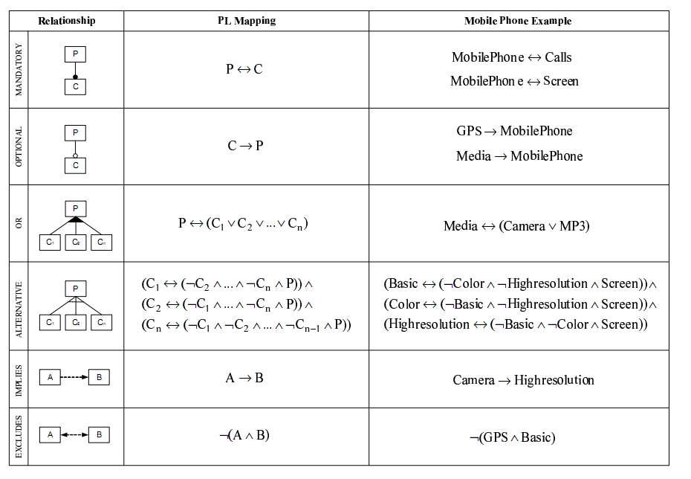
Propositional logic based analysis

Slide 40
Constraint programming based analysis
Constraint Programming can be defined as the set of techniques such as algorithms or heuristics that deal with CSPs.
CSP solvers can deal with numerical values such as integers.
First, translate the feature model to CSP.
Then, use the solver to analysis.
  JaCop, Choco, OPL Studio, GUN Prolop

Slide 41
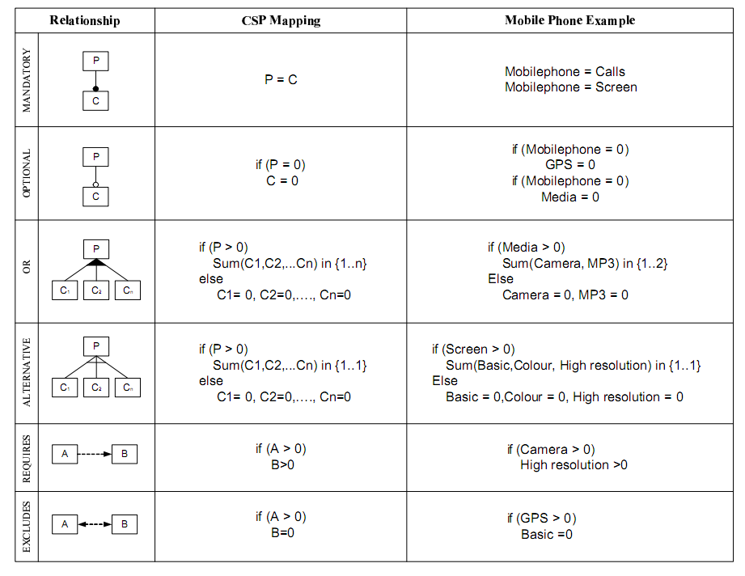
Constraint programming based analysis

Slide 42
Performance Evaluation
In general, the available results suggest that CP-based and PL-based automated support provide similar performance in general.
BDD seems faster, especially when computing the number of solutions.

Slide 43
What’s Next?
Comments about related work
Examples about our work
Compare with related work

Slide 44
Papers I Read (PL-Based)
Mannion,SPLC2002,Using First-Order Logic for Product Line Model Validation
Mannion,PFE,2003 , Theorem Proving for Product Line Model Verification
Batory, SPLC 2005, Feature models, grammars, and propositional formulas

Slide 45
Using First-Order Logic for Product Line Model Validation, Mannion,SPLC2002,
Operations:
  Void Feature Model, Valid Product, Products, #P
Approach:
  Transform the feature model to propositional logic expression
Performance
  Not provided (Since no automatic support)

Slide 46
Using First-Order Logic for Product Line Model Validation, Mannion,SPLC2002,
Strong Points
  First one to propose using logic expressions to analyze feature models.
Weak Points
  No automatic support
  The meta-model of the feature model is not expressive. (Not support requires and excludes)

Slide 47
Theorem Proving for Product Line Model Verification, Mannion,PFE,2003
Operations:
  Void Feature Model, Valid Product, Products, #P
Approach:
  Transform the feature model to propositional logic expression
Performance
  Just a case study (800 features, a industrial example)
  Very little information

Slide 48
Theorem Proving for Product Line Model Verification, Mannion,PFE,2003
Weak Points
  Automatic support, but not mention the tool
  The meta-model of the feature model is not expressive. (Not support requires and excludes)

Slide 49
Feature models, grammars, and propositional formulas, Batory, SPLC 2005,
Operations:
  Dependency analysis (with explanation ), Void Feature Model, Valid Product, Valid Partial Configuration
Approach:
  LTMS
  SAT Solver

Slide 50
Feature models, grammars, and propositional formulas, Batory, SPLC 2005,
LTMS (An AI algorithm)
  Compute propagation
  Provide reasons for variable assignments
  Detect and report contradictions
  Retract and/or make new assumptions
  Maintain a database for backtracking

Slide 51
Feature models, grammars, and propositional formulas, Batory, SPLC 2005,
LTMS (An AI algorithm)
  A feature model → CNF
  P1 ∧P2… ∧Pn
  Pm=C1 ∧C2 …∧Ck
  Cj=T1 ∨T2 …∨Tz
  Satisfied C: some terms are true
  Violated C: all the terms are false
  Unit-Open: one term is unknown
  Non-unit open: more than one term is unkown

Slide 52
Feature models, grammars, and propositional formulas, Batory, SPLC 2005,
SAT Solver
  Void Feature Model, Valid Product, Valid Partial Configuration
Performance
  Only a case study
  No information about the speed

Slide 53
Feature models, grammars, and propositional formulas, Batory, SPLC 2005,
Strong Points
  Use LTMS to propagate and explain
  First use SAT solver to analyze feature model
Weak Points
  Not support retract and reassignment
  Not Support Multi-determine
  No evaluation
  Relation between SAT solver and LTMS?
√
√
√
Notes:
没有说明需要保留什么样的信息，我们证明工作比他好可能就在于我们能真正做出来具有可扩展性的工具。

Slide 54
Papers I Read (PL-Based)
Zhang, MoDELS05, SoSyM06, REJ06, Meta-model and Verification
Zhang, ICSR08 ,A BDD-Based Approach to Verifying Clone-Enabled Feature Models' Constraints and Customization
Yan, ICSR09,An Optimization Strategy to Feature Models' Verification by Eliminating Verification-Irrelevant Features and Constraints

Slide 55
Zhang and Yan
Operations:
  Void Feature Model, Anomaly (not Redundancy)

Slide 56
Papers I Read (CSP-Based)
Benavides,CAiSE2005,Automated Reasoning on Feature Models
Trinidad,JOS,2008,Automated error analysis for the agilization of feature modeling
White,SPLC2008,Automated Diagnosis of Product-Line Configuration Errors in Feature Models

Slide 57
Automated Reasoning on Feature Models, Benavides,CAiSE2005
Operations:
  #P, All Products, Filter, Optimization
Approach:
  Transform the analysis of feature models into a CSP Problem (Solver: OPL Studio)
Performance
  Little information
  Up to 23 features

Slide 58
Automated Reasoning on Feature Models, Benavides,CAiSE2005
Weak Points:
  The performance is bad
  Some results are useless
Strong Points:
  First one to use CSP Solver to solve the problem
  Filter and Optimization is first proposed

Slide 59
Automated error analysis for the agilization of feature modeling, Trinidad,JOS,2008
Operations:
    Anomaly (Dead Feature, False Optional Feature), Void Feature Model
Performance:
  Only a case study
  No information about the speed

Slide 60
Automated error analysis for the agilization of feature modeling, Trinidad,JOS,2008
Approach:
  Transform the analysis of feature models into a CSP Problem (Solver: OPL Studio)
  Dead Feature: For each feature, assign 1 to it, to see if there exists a value assignment that satisfy all the constraints, if not, find the minimal constraints that should behave abnormally.
  Optional false feature
  Void Feature Model

Slide 61
Automated error analysis for the agilization of feature modeling, Trinidad,JOSS,2008
Strong Points:
  Provide possible solutions
  Minimal solutions
Weak Points:
  No Explanation (Half solution half explanation)
  No automatically solve, The minimal idea is naïve
  Performance is bad, amount of calculation is huge
  Not describe how CSP Solver do the tasks
1
2
3
4
√

Slide 62
Automated Diagnosis of Product-Line Configuration Errors in Feature ModelsWhite,SPLC2008
Operations:
  Corrective Explanations
Performance:
  Have experiments
  Random feature model
  5000 features, 350s, not describe the complexity of the feature model

Slide 63
Automated Diagnosis of Product-Line Configuration Errors in Feature ModelsWhite,SPLC2008
Approach:
  1. Free-derive products from feature model
  2. Find all the products using CSP Solver
  3. Compare the customer-derived product with the valid products
  4. Find the minimal changes to customer’s previous decisions

Slide 64
Automated Diagnosis of Product-Line Configuration Errors in Feature ModelsWhite,SPLC2008
Strong Points:
  First one to offer solutions (Assuming the feature model is correct).
Weak Points:
  No Explanation (Solution without explanation is useless, e.g. S{1,2,3,4,5}->S{1,2,3},D{4,5})
  No automatically solve, The minimal idea is naïve
  Performance is bad (even the author admit it), sometimes cannot find the minimal solutions

Slide 65
Outline
Feature Models
Analysis Operations
Automated Support
Our Work

Slide 66
Model Elements, Constraints, Evaluation and Methods
Refinement Relationship
  If the child feature is bound, the parent feature should be bound.
  Two methods
Feature A
A.bindstate =true
D-AB₁
B₁.bindstate =false
Feature B₁
Notes:
B₁

Slide 67
Model Elements, Constraints, Evaluation and Methods
Require
  Two methods
Feature A
Feature B
R-AB
A.bindstate = false
B.bindstate = true

Slide 68
Model Elements, Constraints, Evaluation and Methods
Alternative (Single-Bound)
Feature A
……
Feature B₁
Feature B₂

Slide 69
Model Elements, Constraints, Evaluation and Methods
Or (Multi-Bound)
Feature A
……
Feature B₁
Feature B₂

Slide 70
Transform Feature Models To SkyBlue

Slide 71
A
A
A
M-A
M-A
A
A
A
M-A
M-A
B₁
D-AB₁
D-AB₁
B₁
B₁
Notes:
B₁

Slide 72
A
A
A
M-A
M-A
B₁
D-AB₁
D-AB₁
B₁
B₁
D-AB₁
D-AB₁
C₁
C₂
C₃
C₁
C₂
C₃
C₁
C₂
C₃
……

Slide 73
A
A
A
M-A
M-A
B₁
B₂
D-AB₁
D-AB₁
D-AB₁
D-AB₁
B₁
B₂
M- B₂
B₁
B₂
M- B₂
D-AB₁
D-AB₁
C₁
C₂
C₃
C₁
C₂
C₃
C₁
C₂
C₃

Slide 74
The Proposed Approach For
Feature Model Construction
√
√
√
√
√
Incremental Checking
1.Propagation
2.Explanation (Why the bind state changes, propagation)

Slide 75
The Proposed Approach For
Feature Model Construction
√
√
√
Incremental Checking

Slide 76
The Proposed Approach For
Feature Model Construction
√
√
√
√
√
1.Partial Propagation
3.Anomaly
2.Explanation (Explain anamaly)

Slide 77
The Proposed Approach For
Feature Model Construction
√
2
1
√
√
√
√

Slide 78
The Proposed Approach For
Feature Model Construction
√
2
1
√
√
√
2
√

Slide 79
The Proposed Approach For
Feature Model Construction
Store the revoked constraints
√
2
√
2
1.Automatical Solution (Priority)
2.UNDO
2. Explain (why propagation disappears)
Notes:
不足：能否解释为什么要rovoke它呢？

Slide 80
The Proposed Approach For
Feature Model Construction
√
2
√
0/Remove

Slide 81
The Proposed Approach For
Feature Model Construction
Get the previous revoked constraints back automatically!!!
√
2
1
√
√
√
√
1.Automatical Solution (Priority)

Slide 82
The Proposed Approach For
Feature Model Construction
Locate Conflicts!
√
2
2
√
√
√
2
√
A good property:
Any changes made to the constraints outside the area can not solve the conflicts!

Slide 83
The Proposed Approach For
Feature Model Construction
√
2
√
2
UNDO
Analyst solve the conflicts by changing the priority or just remove the constraint!

Slide 84
The Proposed Approach For
Feature Model Debugging
√

Slide 85
The Proposed Approach For
Feature Model Debugging
√
√
√
3
2
3

Slide 86
The Proposed Approach For
Feature Model Debugging
√
√
√
3
2
3
Locate Conflicts!
Automatically solve the conflicts!
A good property:
Any changes made to the constraints outside the area can not solve the conflicts!

Slide 87
The Proposed Approach For
Feature Model Configuration
A new way of configuration
  Give priorities to the selection and deselection
√
√
√
√
√
√
X
2
2
1
2
2
1
√
The revoked constraints are stored!!!

Slide 88
The Proposed Approach For
Feature Model Configuration
A new way of configuration
  Support UNDO, Automatically add the previous revoked constraints
√
√
√
√
X
X
√
1->0
2
1
0
2
1
√

Slide 89
 | Void FM | Valid Partial Configuration | Anomaly | Propagation | Explanation | Solution | #P | Valid Product | All Products | Filter | Optimization | Multi Con
Construction | √ |  | √ | √ | √ | √ | √
Debug |  | √ |  | √ | √ | √
Configuration |  | √ |  | √ | √ | √ |  |  | √ | √ | √ | √
Design and Implementation |  |  |  |  |  |  |  | √
Domain Evolve |  |  |  |  |  |  |  | √
 | Core Features | Variant Features | Feature Model Relation
Construction
Debug
Configuration
Design and Implementation | √ | √
Domain Evolve |  |  | √
My Operation : UNDO

Slide 90
Compare with related work
Incremental Checking
  Not used before in feature model analysis
  Incremental SAT Solving
Propagation
  Don Batory (LTMS)
  Support undo and new assignment

Slide 91
Compare with related work
Anomaly
  Trinidad
  Incremental checking and Faster
  Provide explanation and automatically solve
  Automatically turn back
Solve Conflicts:
  Trinidad (Construction Stage), White (Configuration Stage)
  Explanation
  Automatically solve
  Automatically turn back

Slide 92
Thank You!

